Slide 1
Microprod Policy Dialogue:
COVID and productivity
18 March 2021
Filippo di Mauro
Chairman of CompNet

Slide 2
Outline for today
Covid has disrupted all aspects of our life and inflict tremendous costs to the economies
Assessing the Covid impact on productivity will become critical, to ensure that the recovery will be balanced and sustainable
What do we know one year after Covid-19 erupted?
We will provide a quick and simple conceptual framework
…and indicate some initial results across the globe
This to introduce the 3 EU country specific findings
Notes:
As we see some light after the tunnel,

Slide 3
Dissecting productivity: a primer
Production function
Y = f(A, K, N)
➔
Total Factor Productivity
Between firms
Within firms
Net Entry effect
Allocative Efficiency
Internal efforts/
characteristics
(marketing, technology,
costs…)
New (more productive) firms entering
Bad firms exiting
Resources (L and K) going to most productive firms, which become larger

Slide 4
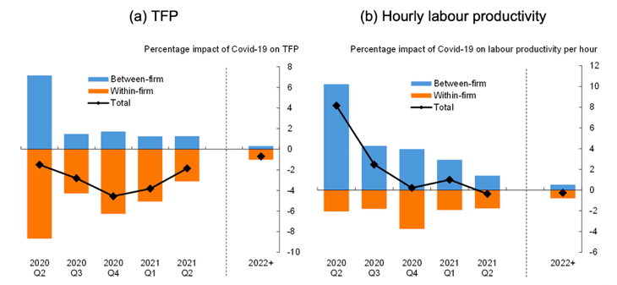
Between-firms attenuates within-firms effect in the UK
The effect on within-firm productivity is negative: firm expect to be losing efficiency partly because measures to contain Covid-19 are expected to increase intermediate costs
These negative effects, however, are partially offset by a positive between-firm effect as low productivity sectors, and the least productive firms among them, are disproportionately affected.

Slide 5
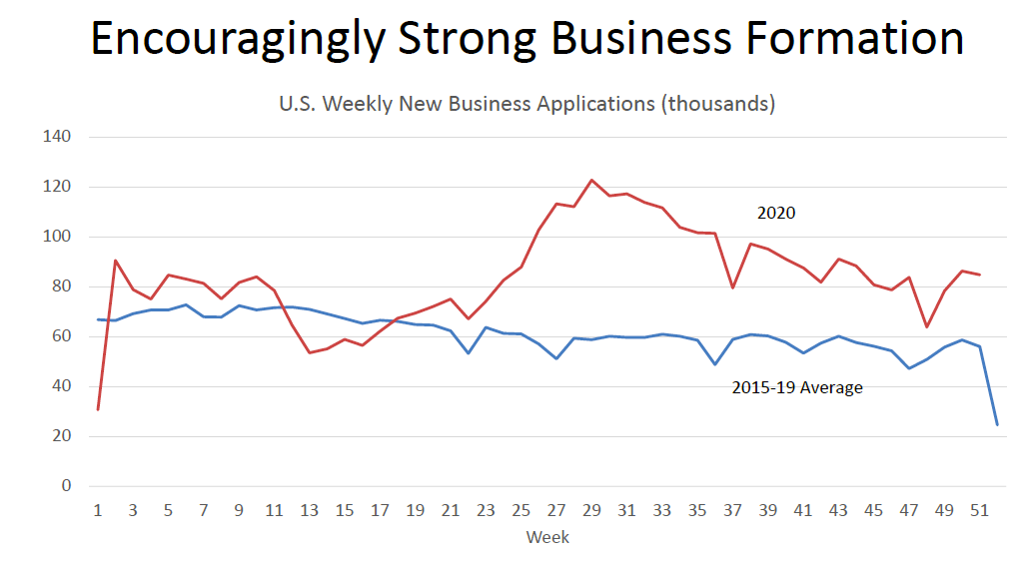
Net entry effect unusually positive in the US
In the US a positive and encouraging business formation trend is present. We need to understand to which extent this phenomenon can boost future productivity growth

Slide 6
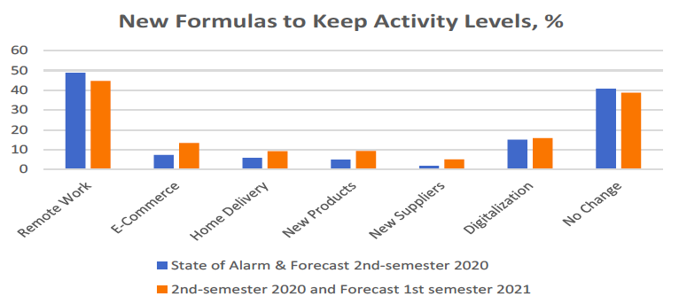
Within-firms impact are positive in Spain for incumbents
Existing firms are changing the way in which they are conducting business in order to keep pre-crisis activity levels.
The most common change is clearly remote work, but other changes are present in a significant % of firms. However, a large amount of firms did not change anything.

Slide 7
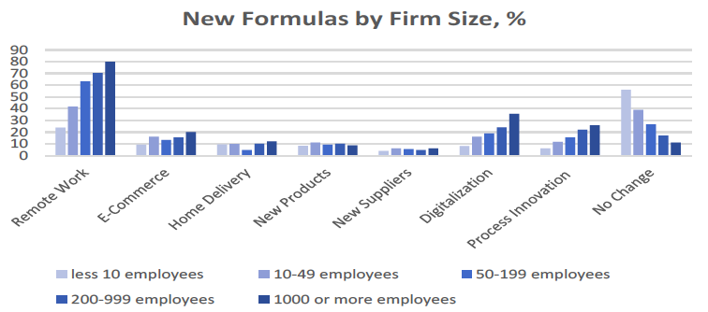
… but changes are concentrated among large firms
Changes in remote work, digitalization and process innovation are concentrated among large firms.

Slide 8
No generalized signs of supply chains (GVC) disruption
Daily estimates (30-days MA) of GVC related trade for 2020 as a share of 2017-19 average
…but the impact varies across EU countries
- negative in France
- with some sign of recovery in GER, ITA, SPA

Slide 9
Conclusions
Possibly, so far, across the globe, the impact of COVID on productivity was less damaging than feared
Including, because of some “cleansing effects” across firms/sectors
Data are still scarce, but MICROPROD and CompNet will be able to offer soon some more systematic cross-country indication
➔ Let’s go to some specific country findings
Notes:
As we see some light after the tunnel,

